Slide 1

Object Detection
Landmark detection
deeplearning.ai

Slide 2
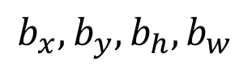
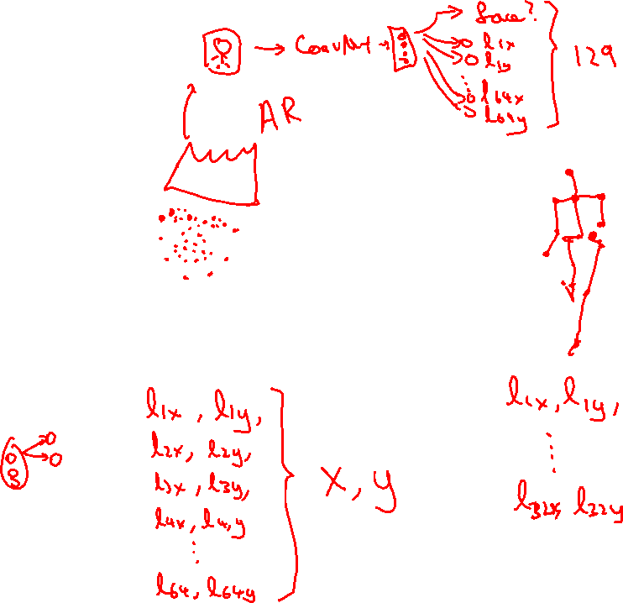
Landmark detection
ConvNet
$$b_{x},b_{y},b_{h}, b_{w}$$
Notes:
so you can just have a neural network have
its final layer and have it just output two more numbers which
I'm going to call our lx and ly
64*2 + 1

